Slide 1
Modern Web Development Using React
Olgun DUTKAN – UI / UX Takımı
odutkan@havelsan.com.tr

Slide 2
PRESENTATION CONTENT
Moder Web Development Tools
React
Material UI
Socket connection on React with Socket.io

Slide 3
What is Modern Web Development Means?
Reusable components
More performance web applications
Single page web applications
Writing web applications with JavaScript libraries and using other advanced JavaScript tools

Slide 4
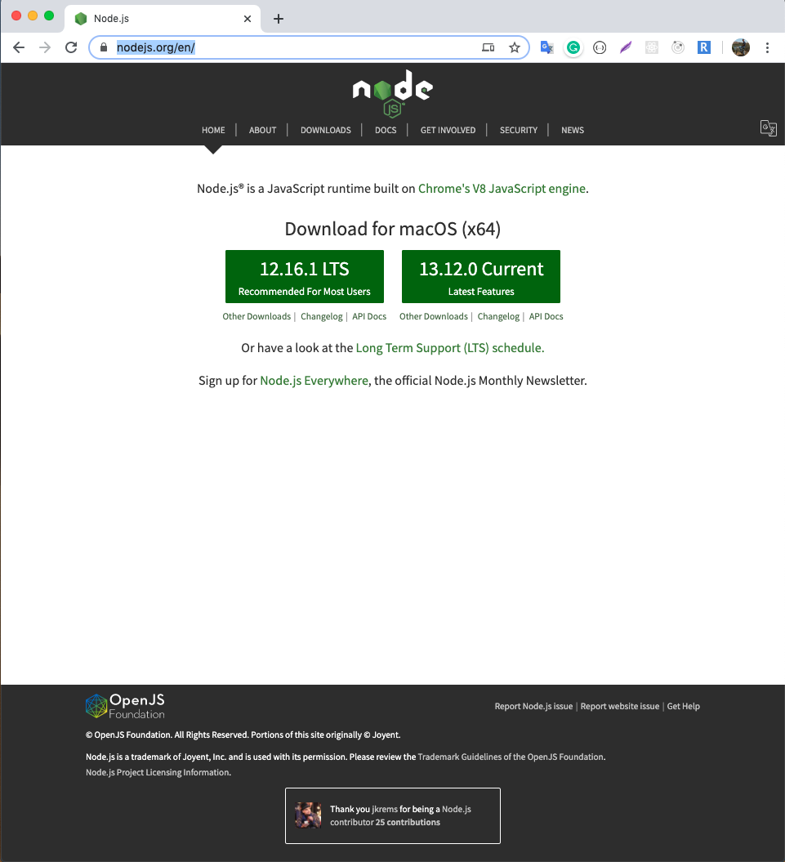
NODE JS
https://nodejs.org/en/
Node.js is open source and can run on the server side.
Node.js is a JavaScript runtime built on Chrome's V8 JavaScript engine
It can work anywhere without needing web browsers.
It is a platform where you can develop console applications with JavaScript codes.

Slide 5

NPM (Node Package Manager)
NPM is basically a tool that works on the command line, to install 3rd party software.
Dependencies injection management
After installing NodeJS, You can check the version of NodeJS and NPM
`node --version`
`npm --version`
`npm --help`

Slide 6
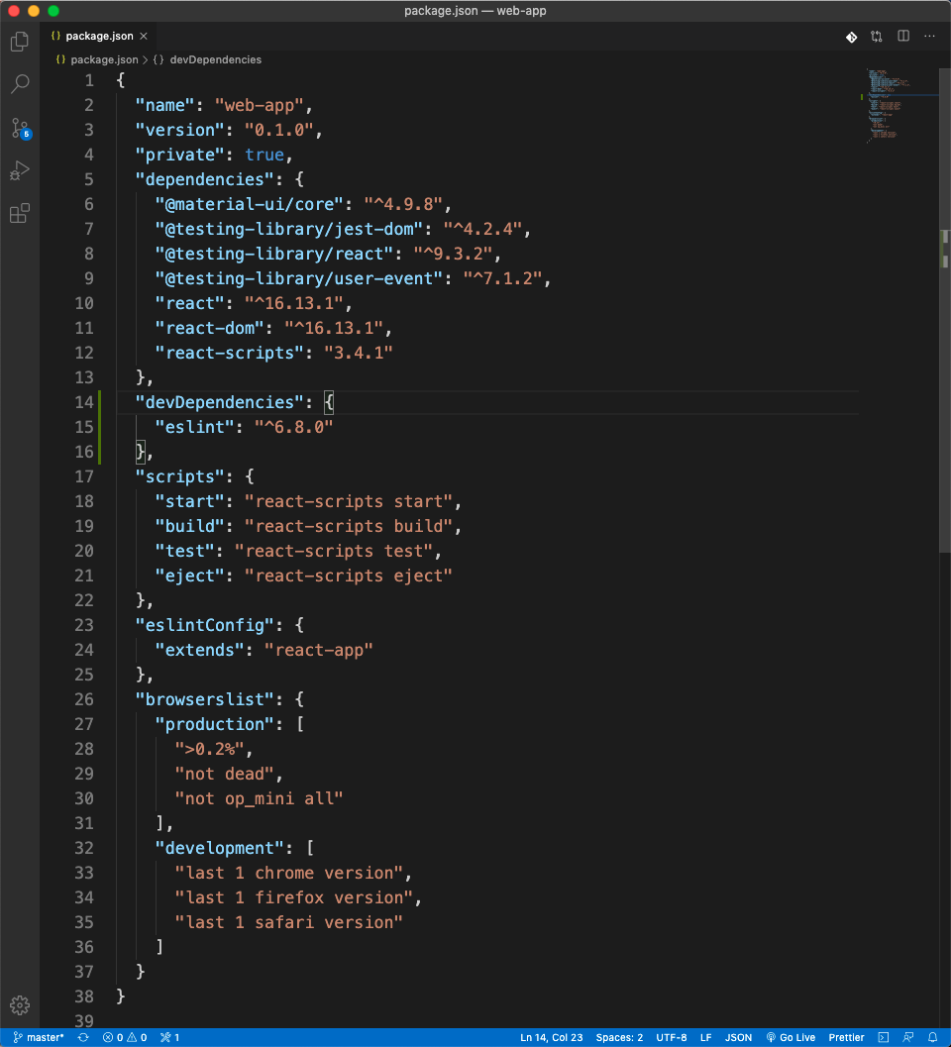
package.json
The package.json is the project manifest file.
Using package.json you can manage dependencies and write scripts.
It has all the meta data about the project.

Slide 7
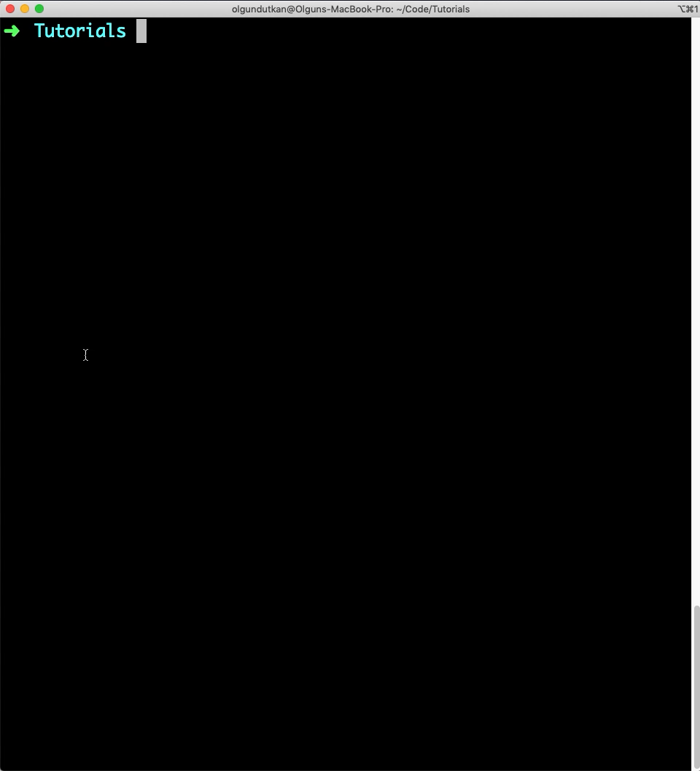
Creating package.json
First, head over to your project folder. You can create package.json from the command line.
`npm init`

Slide 8
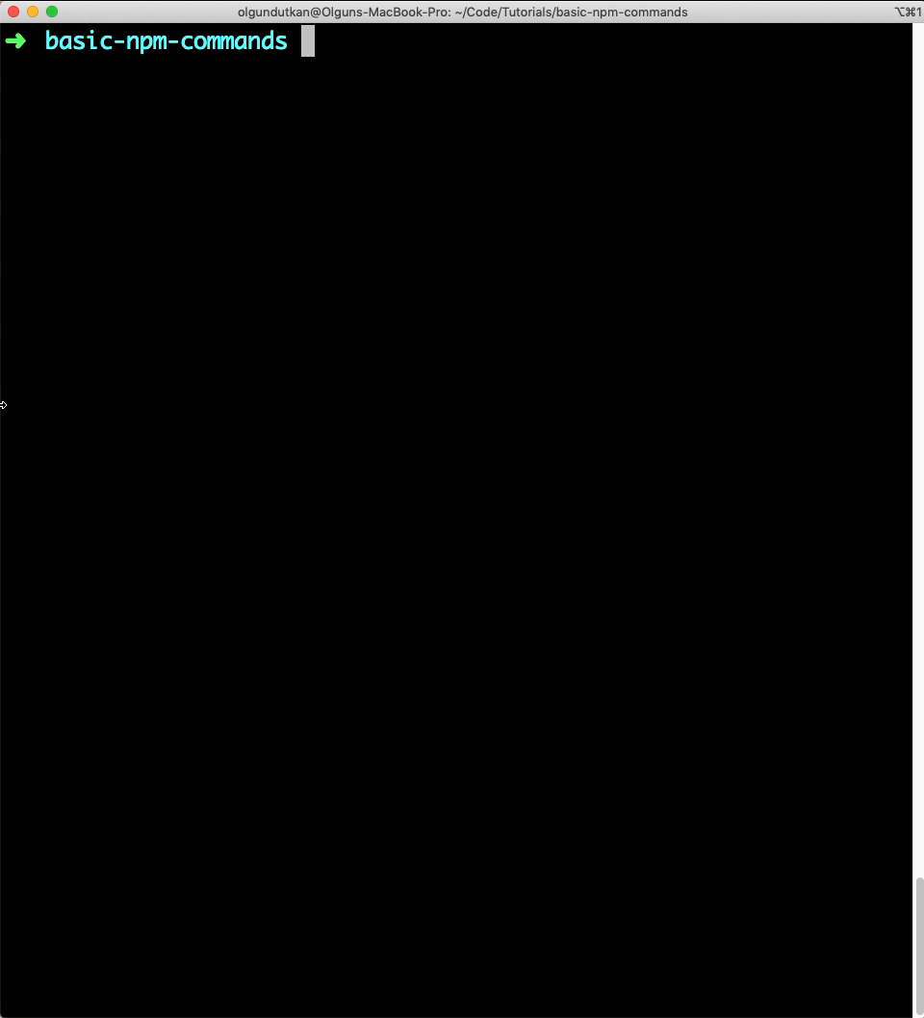
BASIC NPM COMMANDS
Installing package commands
`npm install`
`npm install --save <package>`
`npm install --save-dev <package>`
`npm install --global <package>`

Slide 9
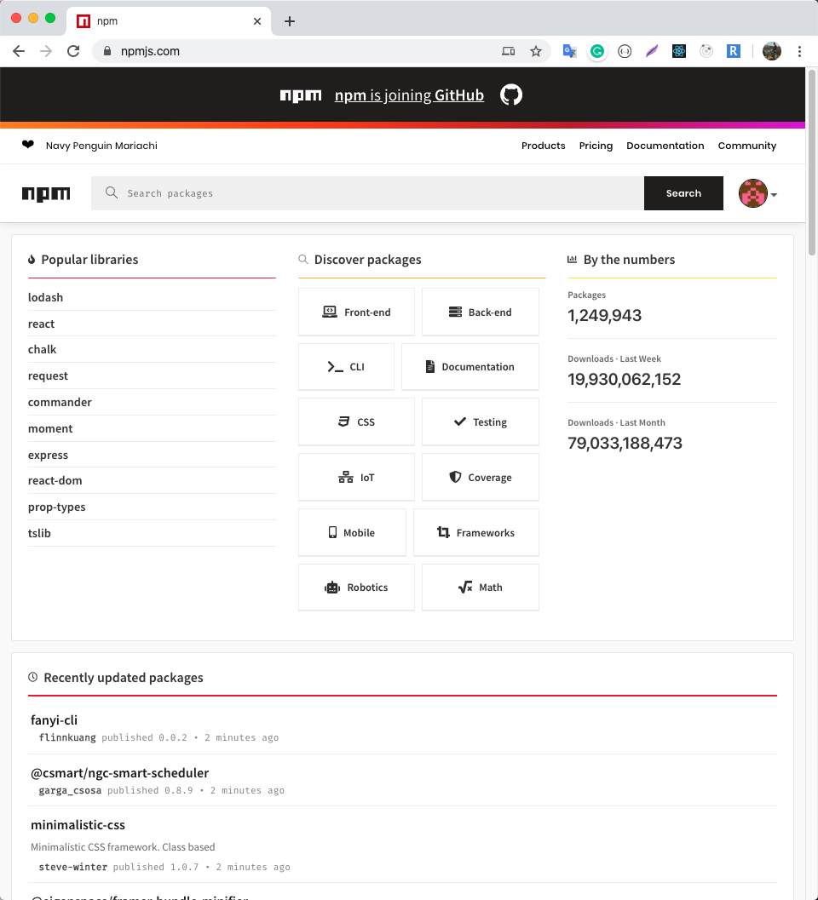
NPM Packages
https://www.npmjs.com/
A plethora of Node.js libraries and applications are published on npm, and many more are added every day.
These applications can be searched for on http://npmjs.org/.
Once you have a package you want to install, it can be installed with a single command-line command.

Slide 10
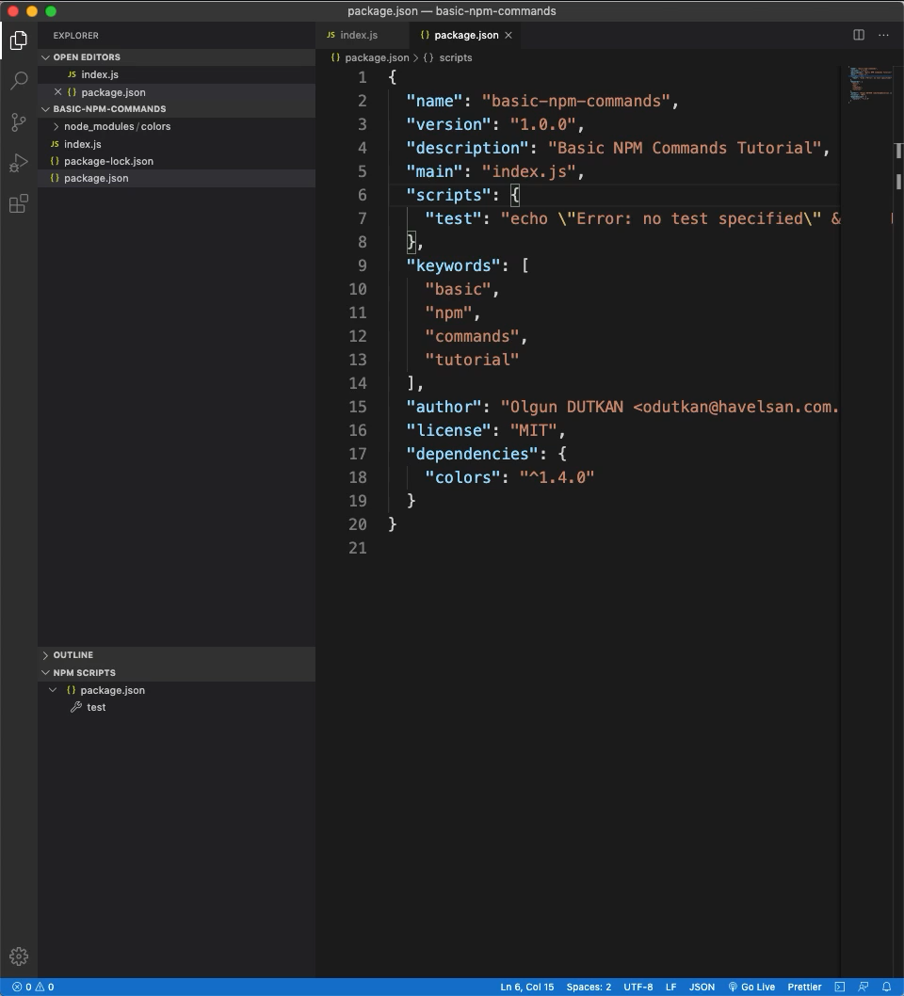
BASIC NPM COMMANDS
Used for repetitive tasks
You can start your project with a single command.
Scripts are also used in deleting temporary files and folders, etc.
`npm run <script>`

Slide 11
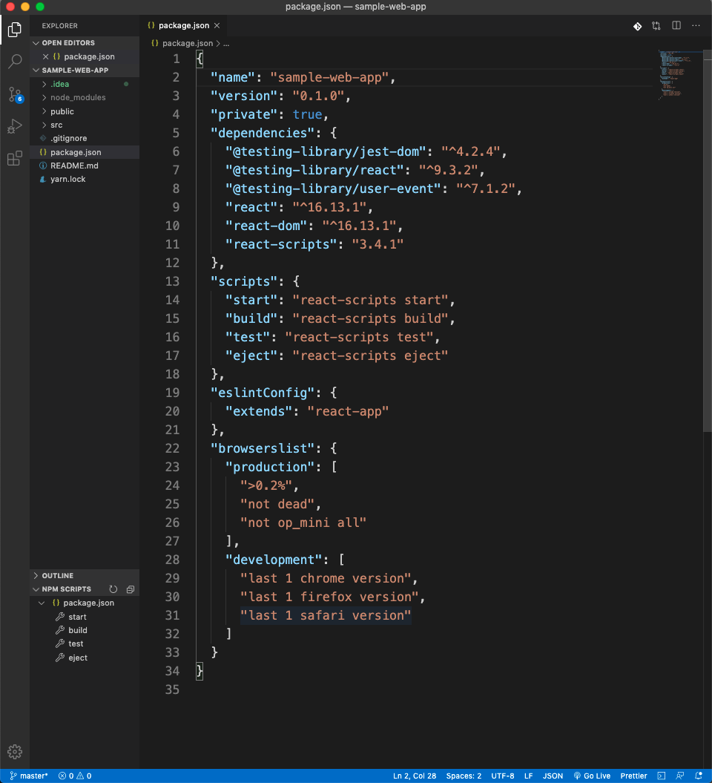
VS Code
https://code.visualstudio.com/download
Free.
Built on open source.
Runs everywhere.

Slide 12
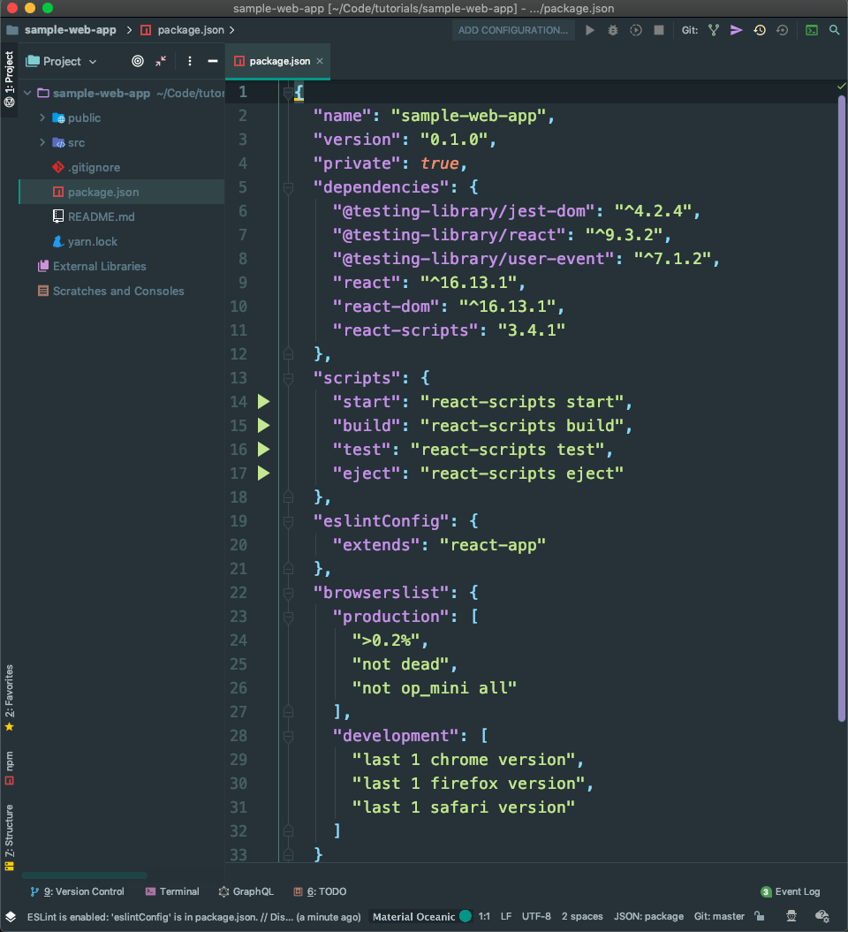
WebStorm
https://www.jetbrains.com/webstorm/
The smartest editor
Use the full power of the modern JavaScript ecosystem
JavaScript, TypeScript, stylesheet languages, and all the most popular frameworks.

Slide 13
EcmaScript
Every browser has a JavaScript interpreter.
ECMAScript is a Standard for a scripting languages.
Languages like JavaScript are based on the ECMAScript standard.
EcmaScript speeds the development process and allows us to write code more clearly.
ECMA means European Computer Manufacturer’s Association

Slide 14
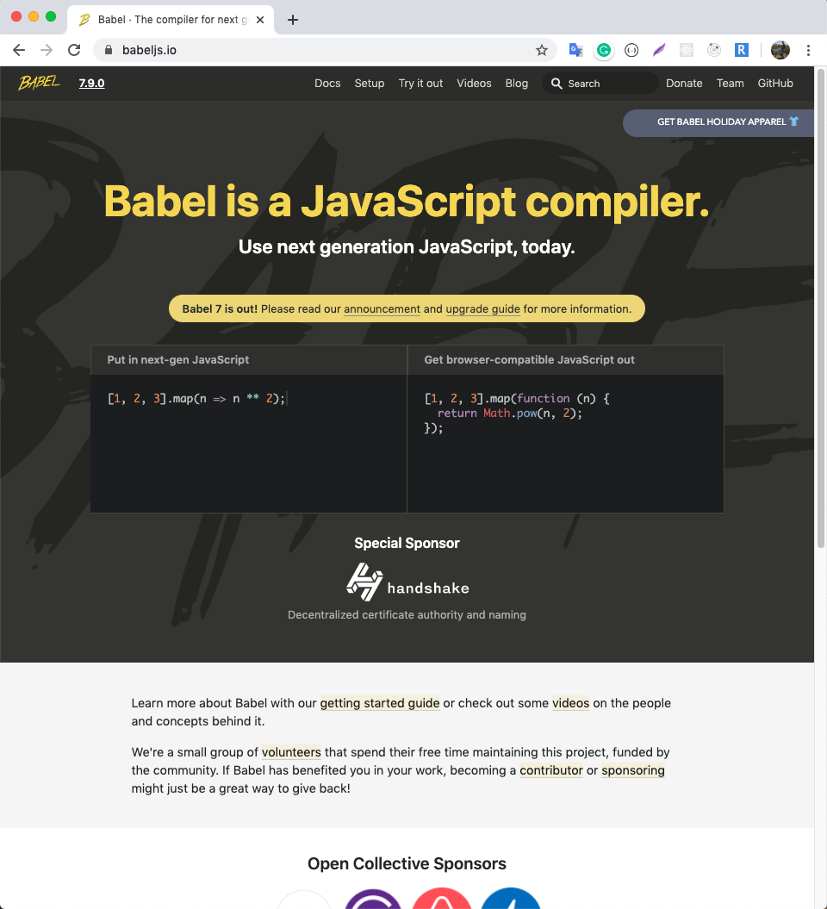
BabelJS
https://babeljs.io
BabelJS is the most popular transpiler that transforms new JavaScript ES6 to Old JavaScript ES5.
BabelJS makes it possible for writing the next generation of JavaScript

Slide 15
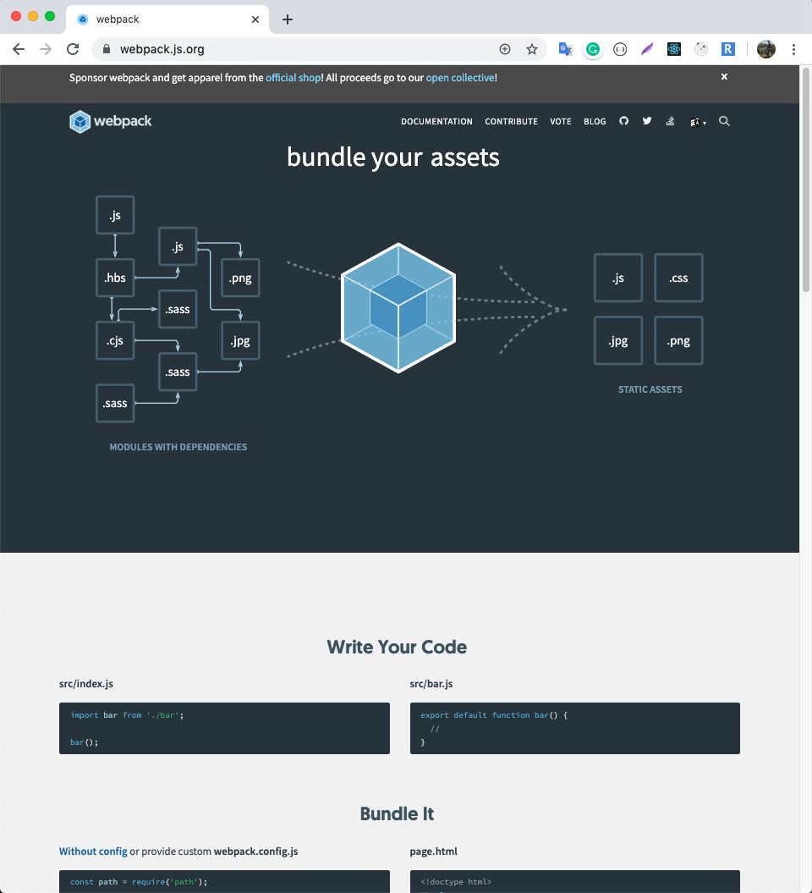
WEBPACK
https://webpack.js.org
At its core, webpack is a static module bundler for modern JavaScript applications.
It can transform front-end assets like HTML, CSS, and images if the corresponding loaders are included.

Slide 16
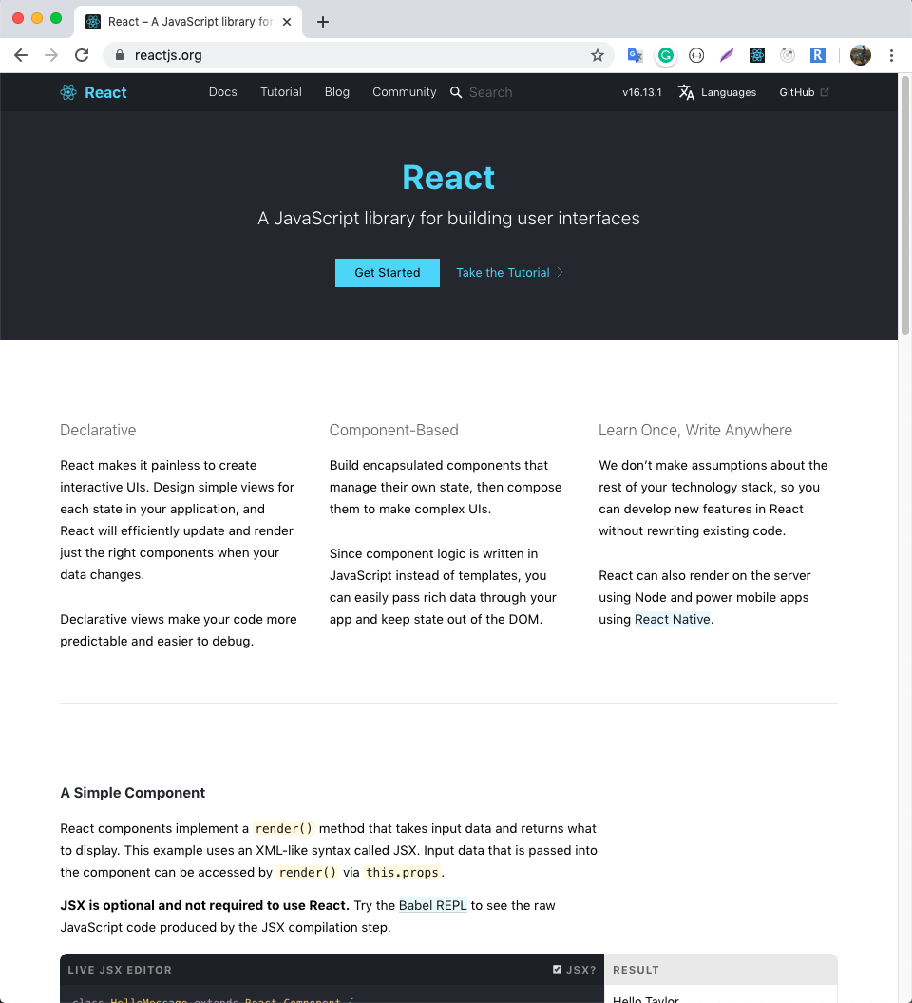
ReactJS
https://reactjs.org
A JavaScript library for building user interfaces.
React can be used as a base in the development of single-page or mobile applications.
React is only concerned with rendering data to the DOM

Slide 17
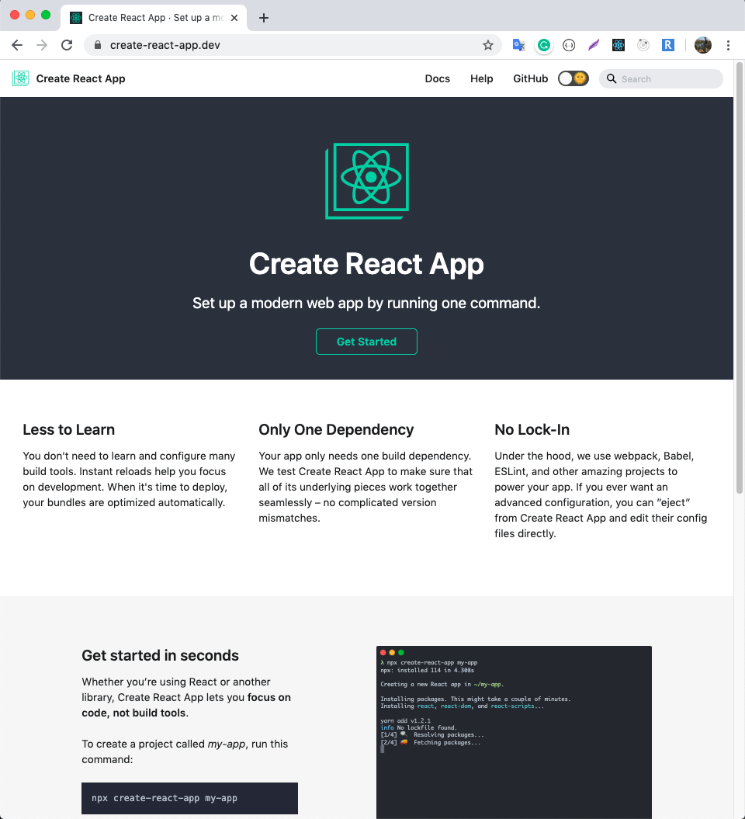
Create a New React App
https://create-react-app.dev/docs/getting-started/
Create React apps with no build configuration.
Create React App works on macOS, Windows, and Linux.
https://github.com/facebook/create-react-app

Slide 18

Installation and Create a New React App
`npm install -g create-react-app`
`create-react-app <name>`
`cd <name>`
` npm start `

Slide 19
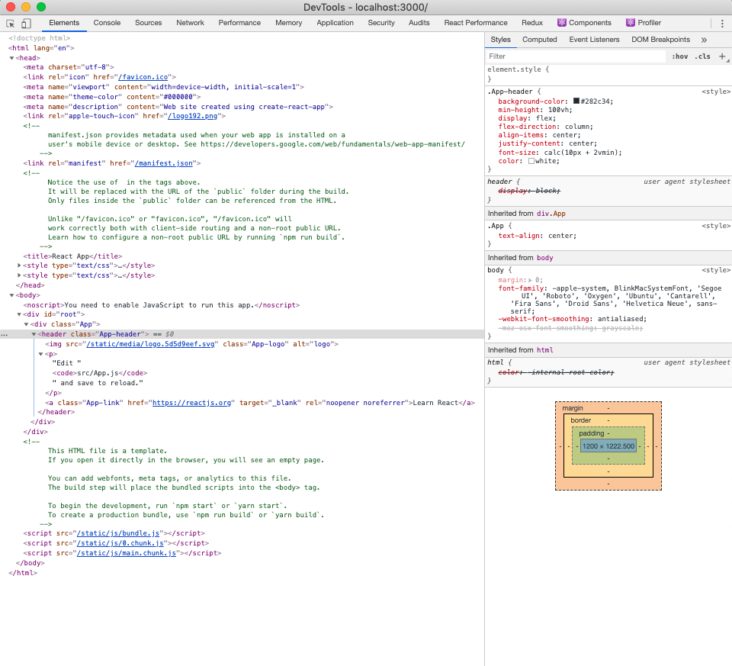
Source Code

Slide 20
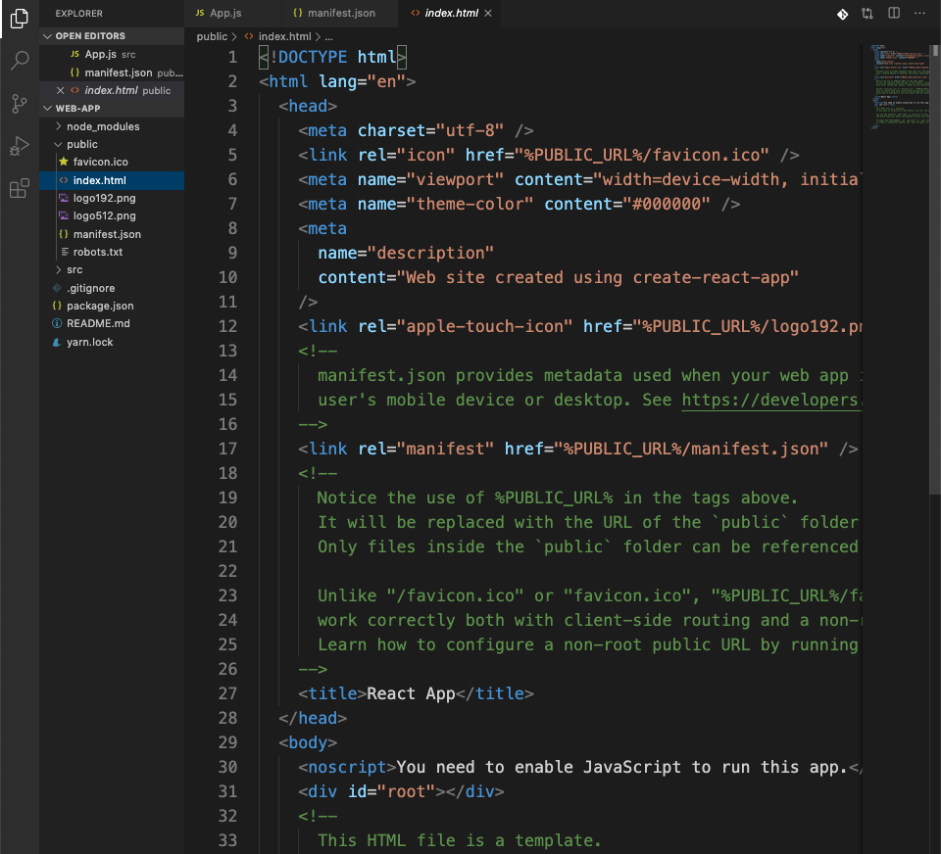
How to change html template?
Open <project name>/public/index.html file in your editor.
Can you remove comment out lines
Can you add new meta tags

Slide 21
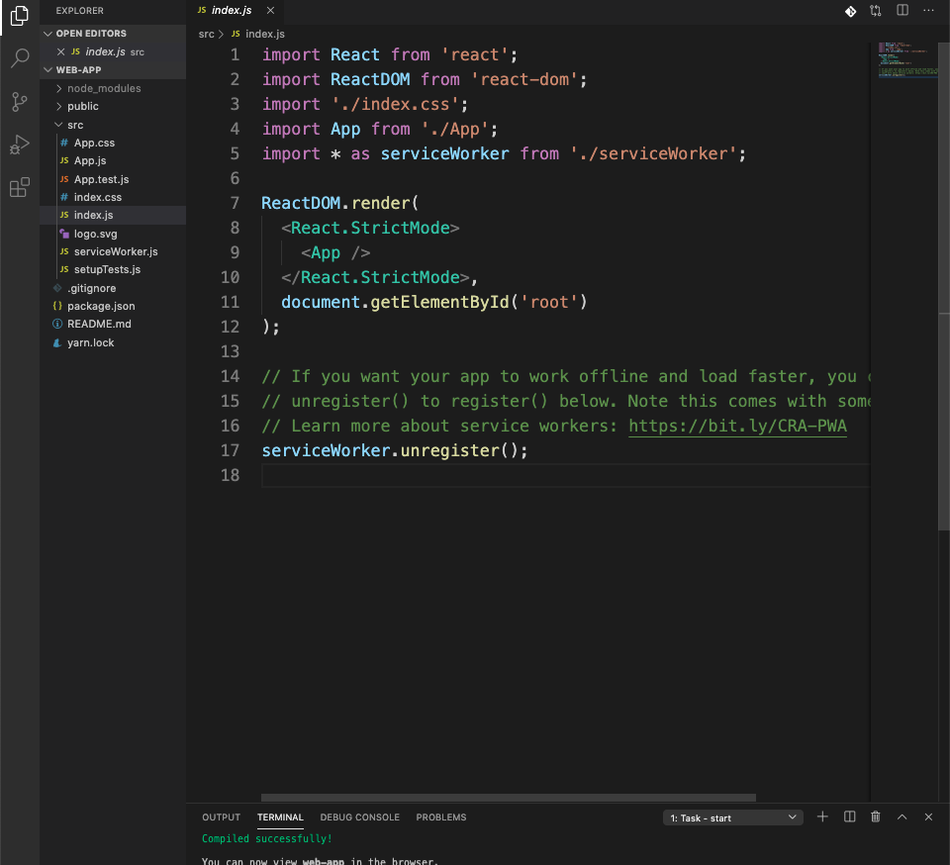
First File in the Code

Slide 22
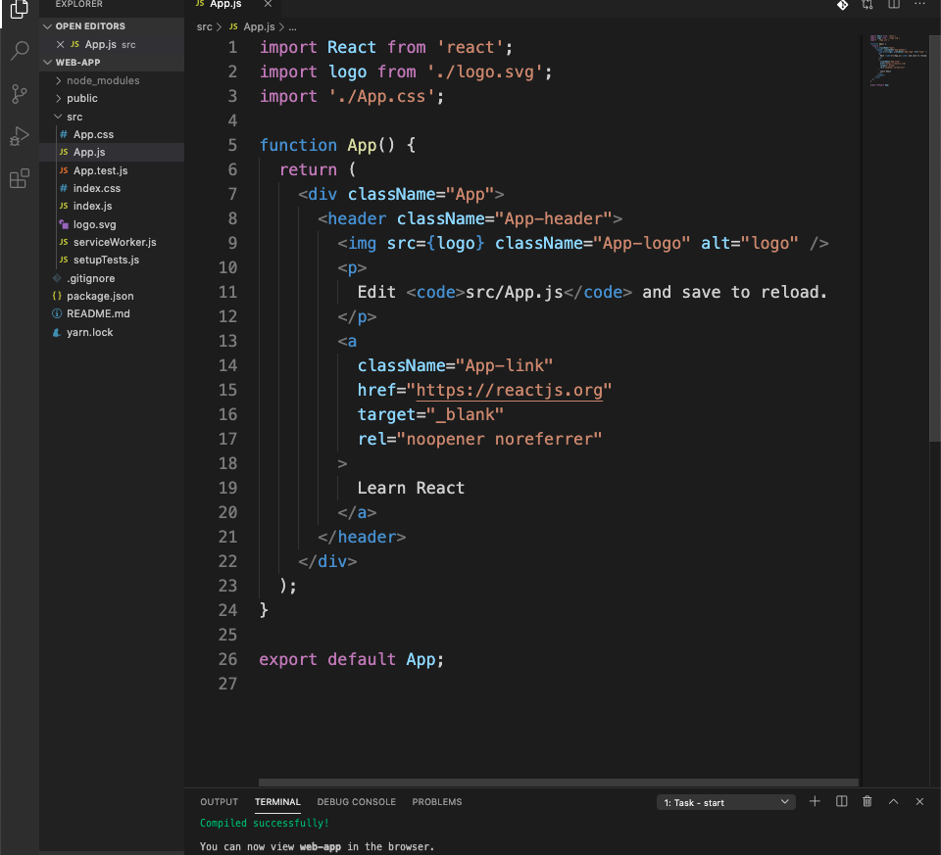
First Component in the Code

Slide 23
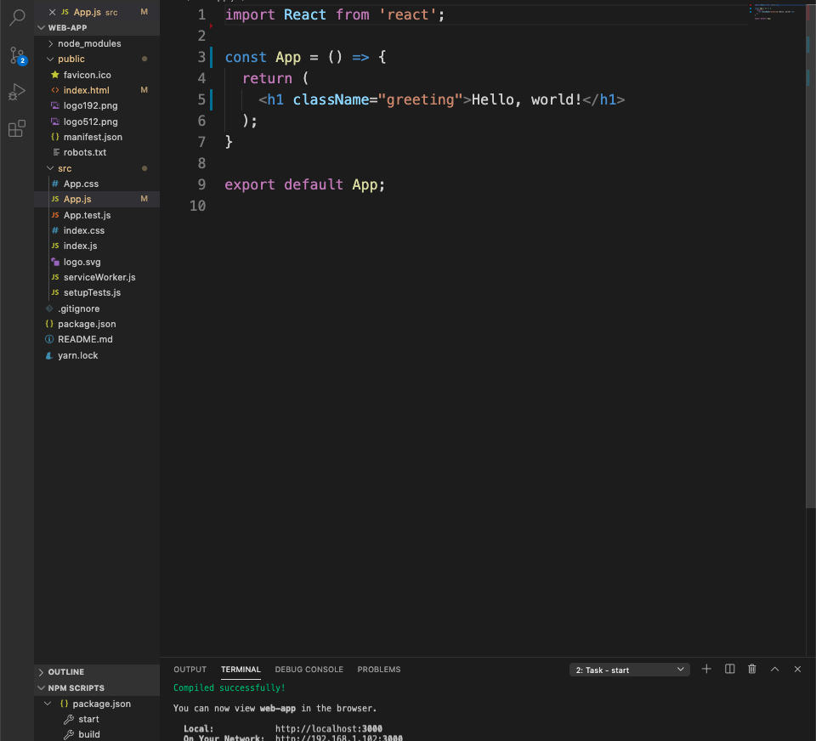
What is JSX?
Not a string or HTML
It is a syntax extension to JavaScript.
Determines how the interface should look

Slide 24
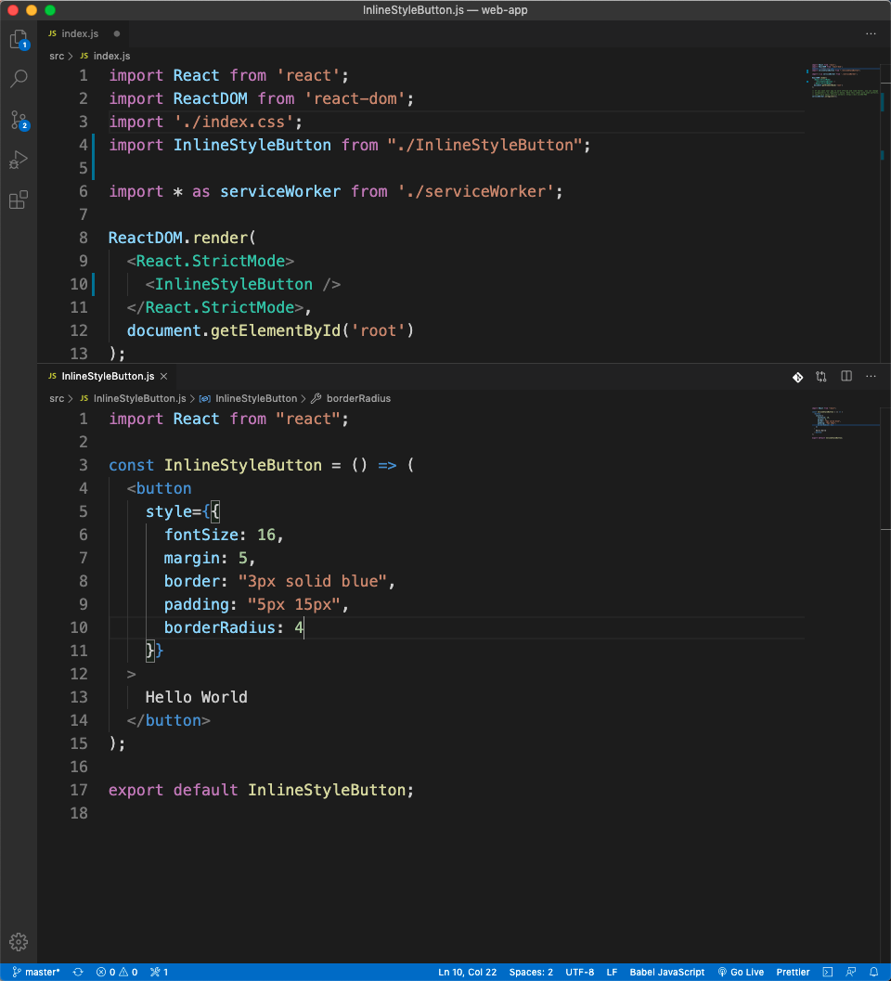
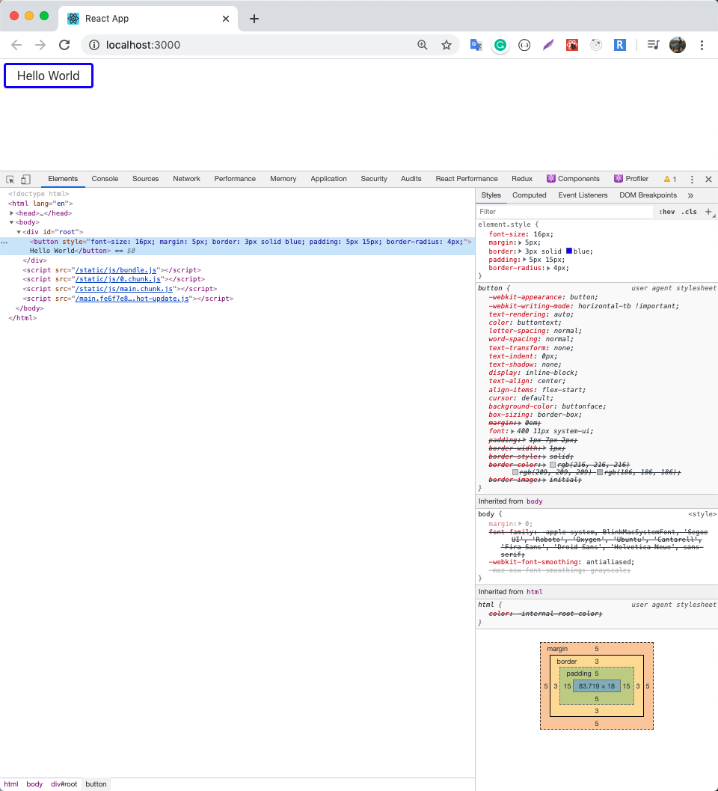
Using Inline Styles in JSX

Slide 25
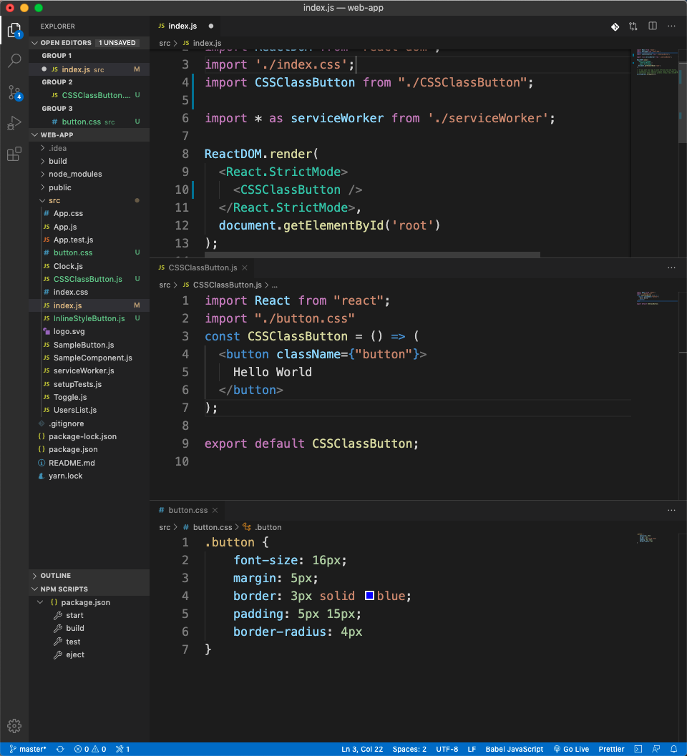
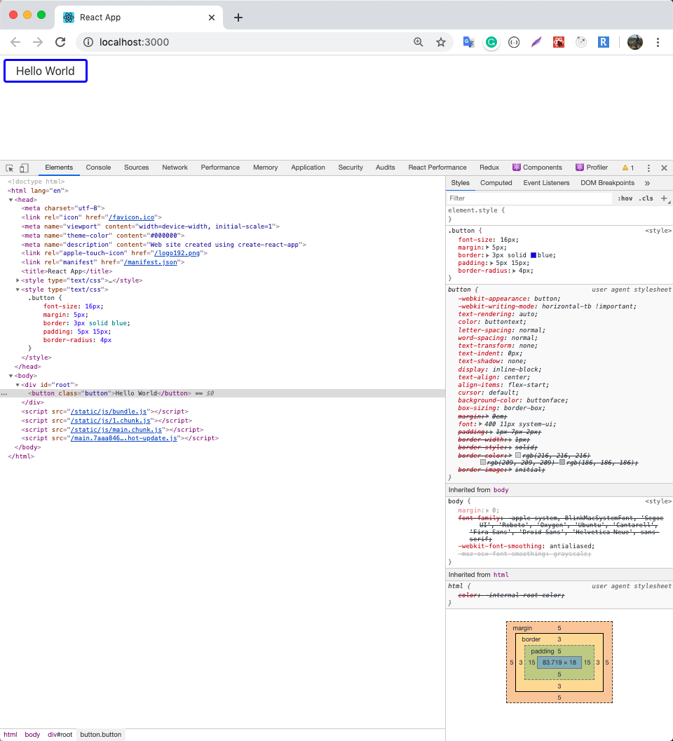
Using CSS Classes in JSX

Slide 26
Rendering Elements
An element depicts what you want to see in your application
Everything is managed by ReactDom
React only updates what’s necessary

Slide 27
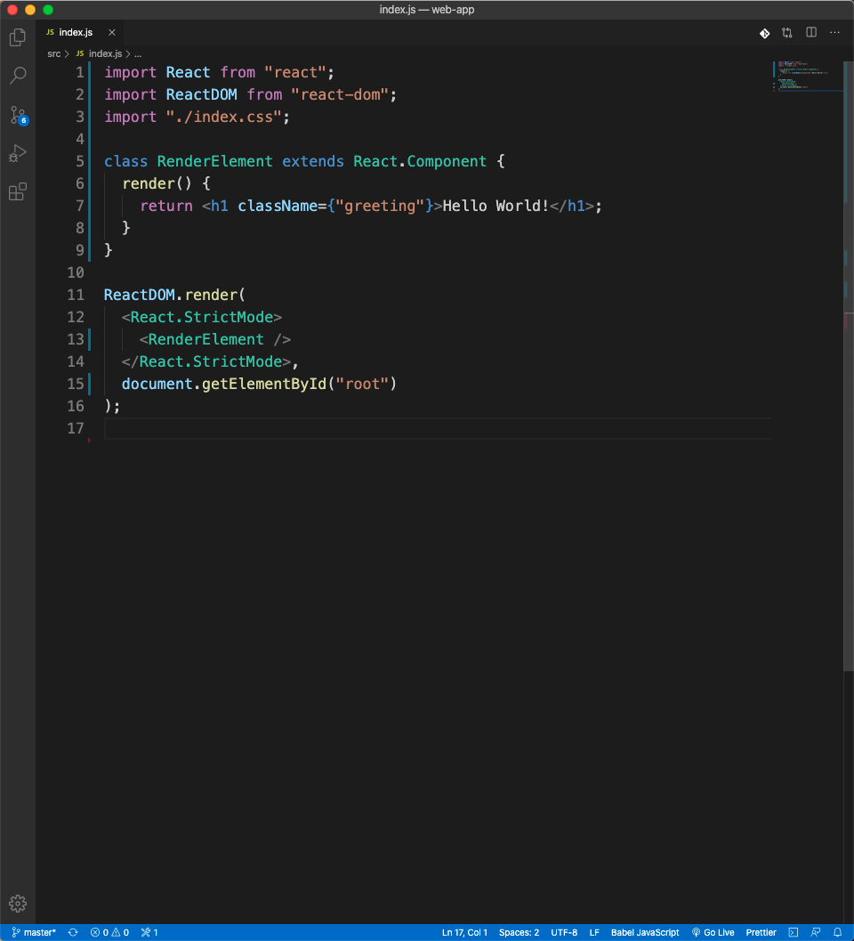
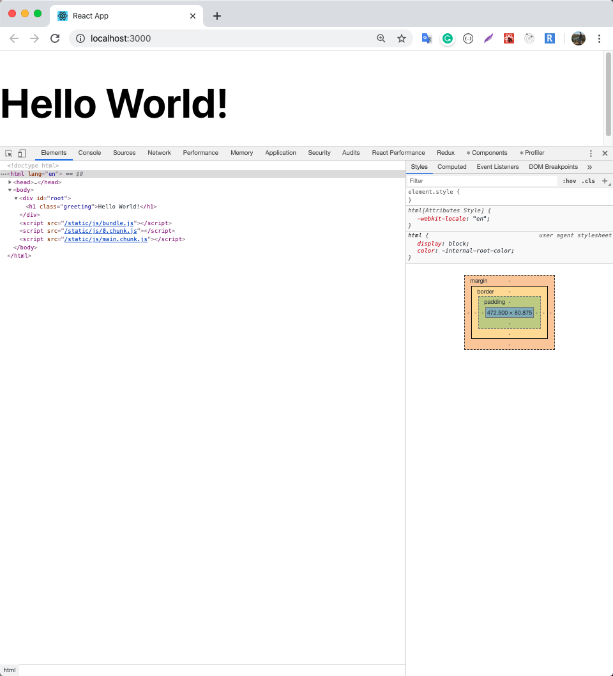
Rendering Element

Slide 28
Components and Props
Reusable pieces
Think about each piece in isolation
Components are like JavaScript functions

Slide 29
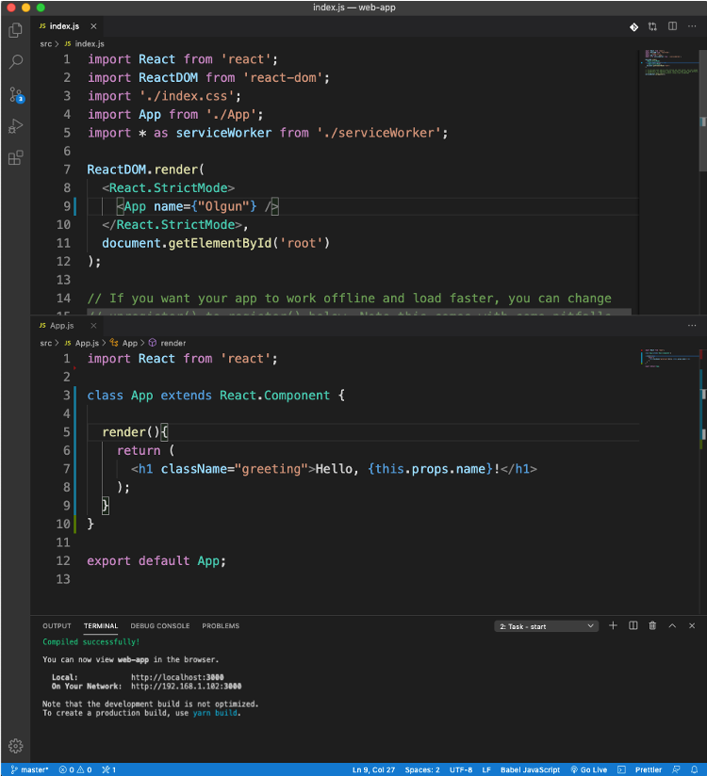
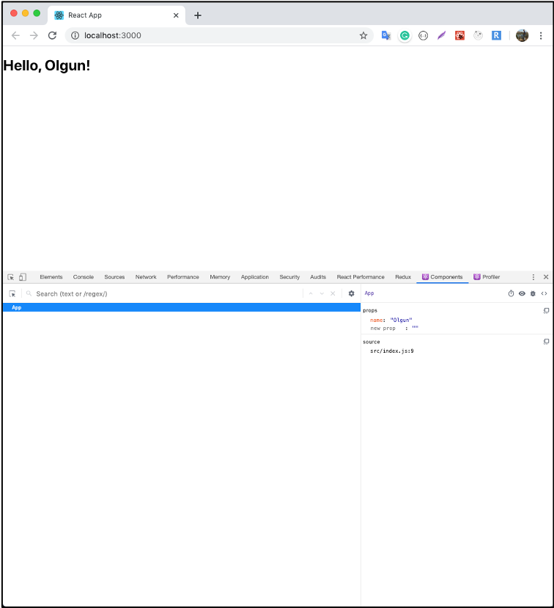
Components and Props

Slide 30
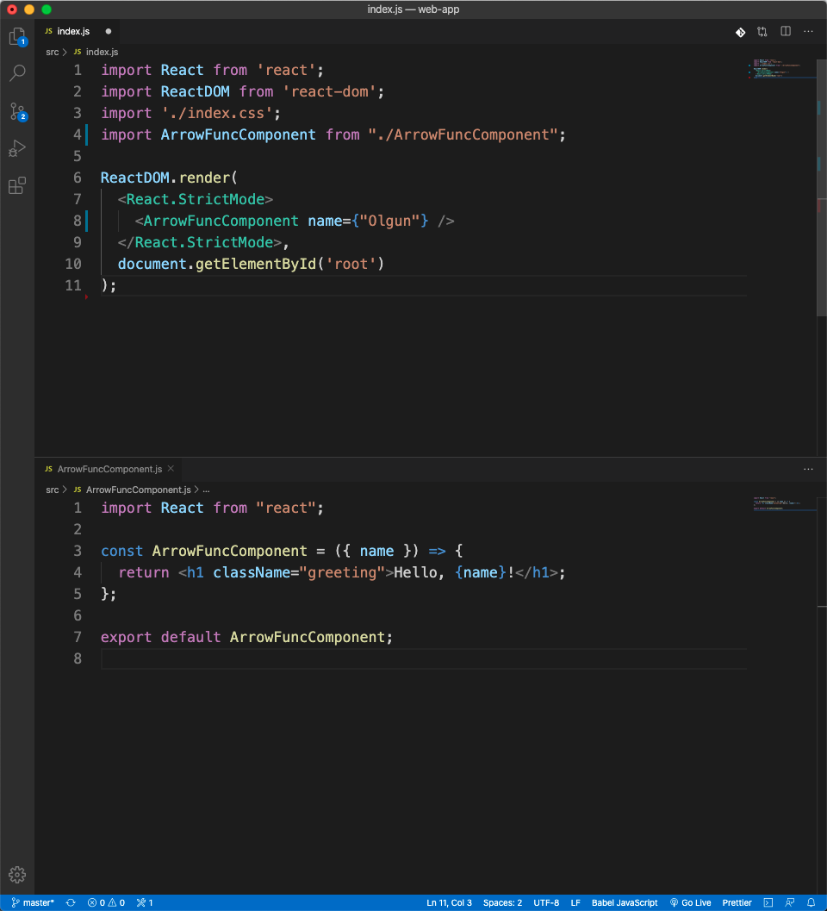
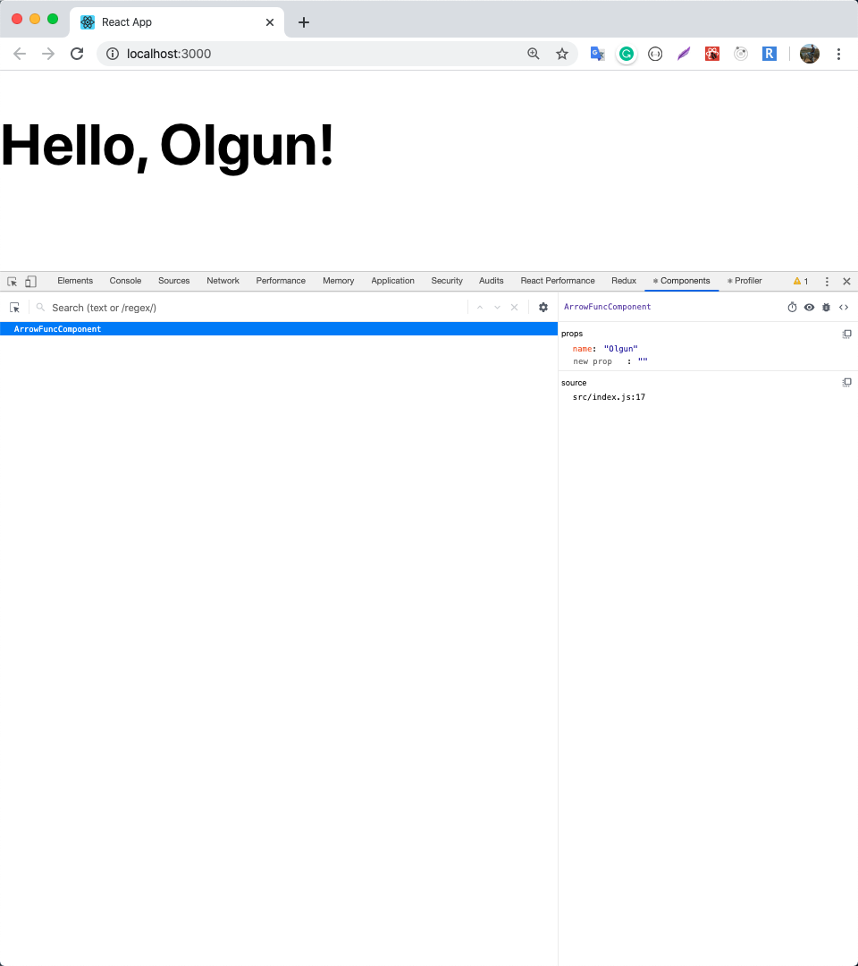
Components and Props

Slide 31
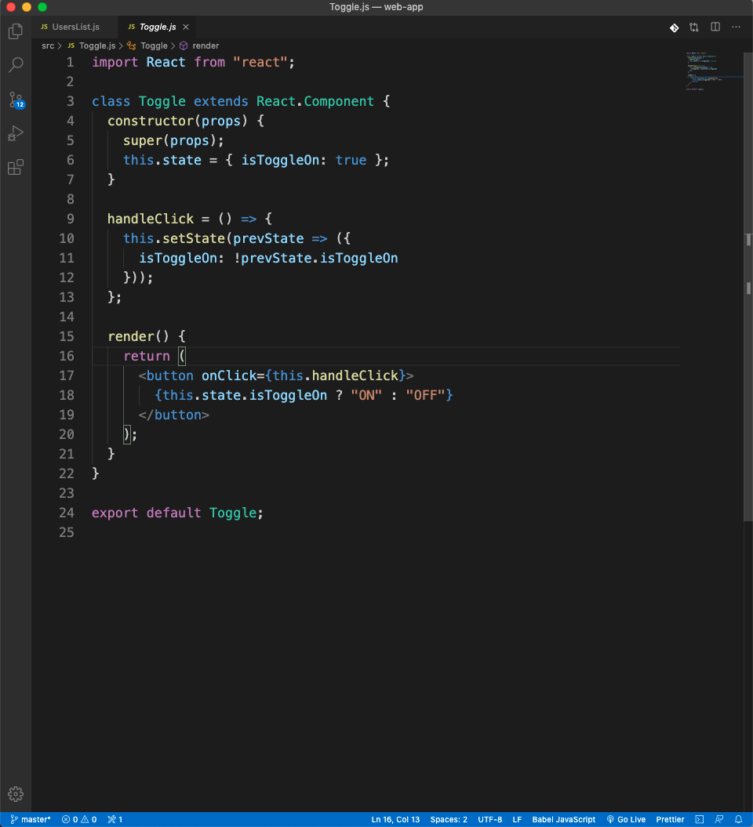
State and Lifecycle
State is like props
It is private and fully controlled by the component.
Initial state
`this.state = { key: value };`
Update state
`this.setState({key: value});`

Slide 32
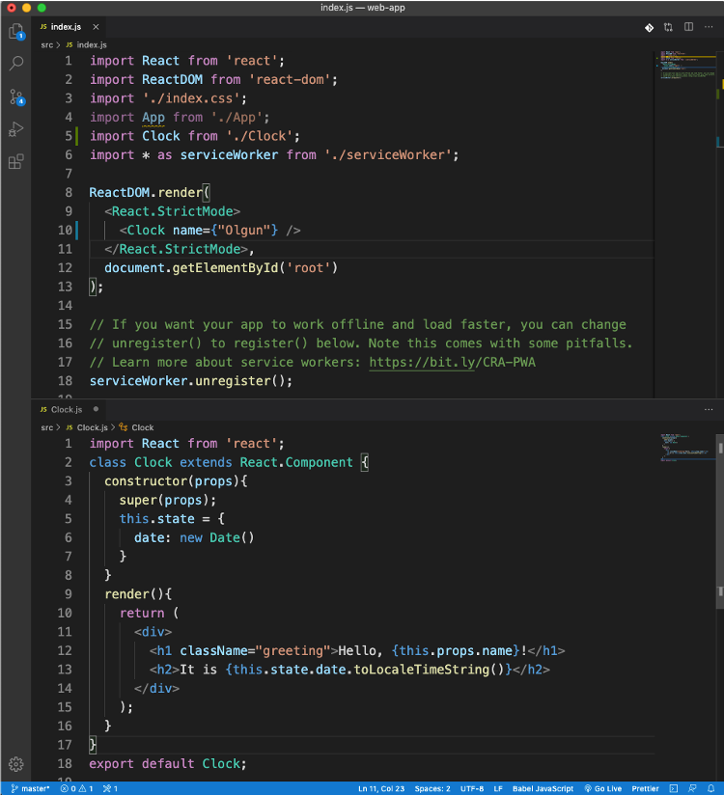
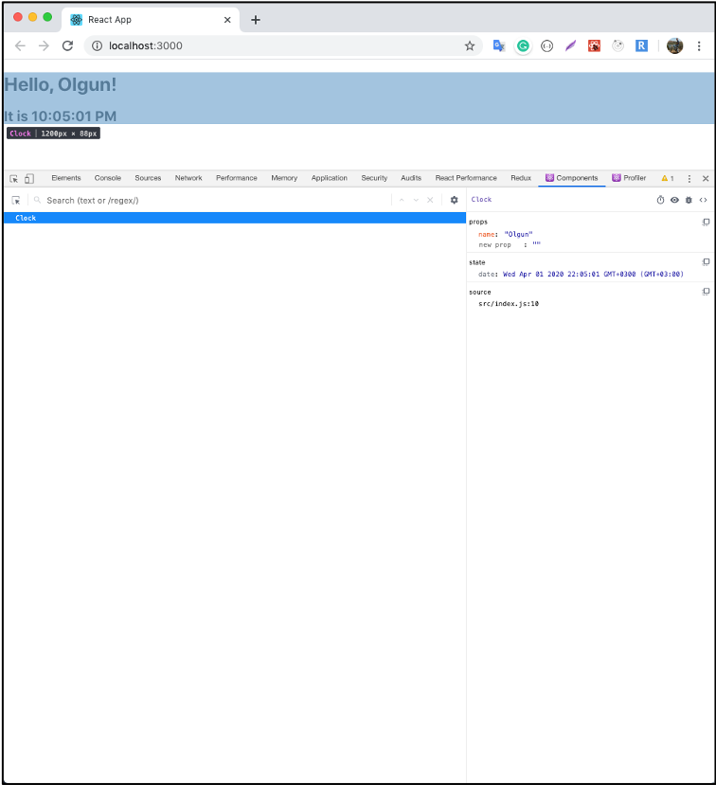
State and Lifecycle

Slide 33
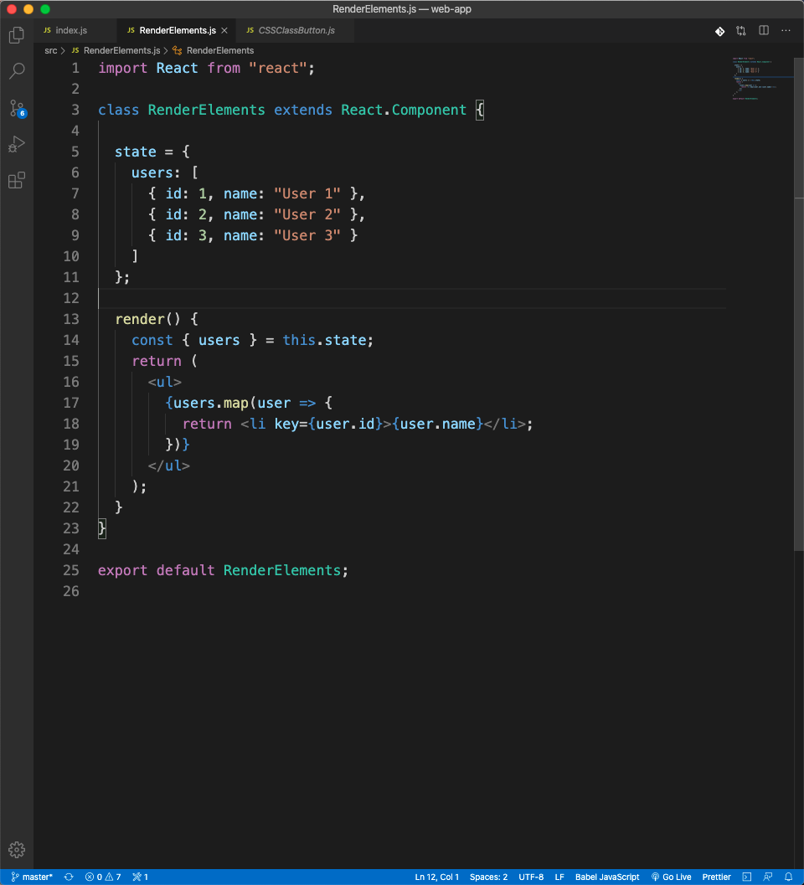
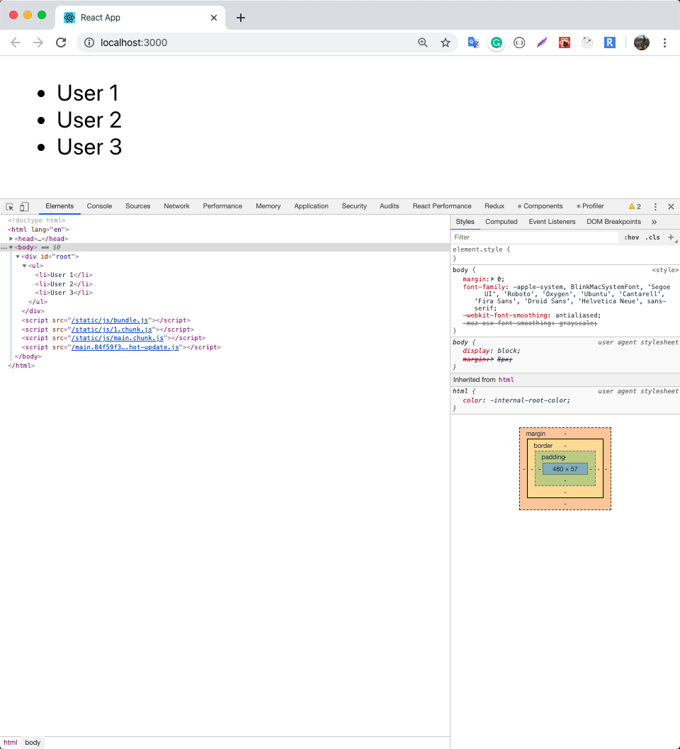
State and Lifecycle

Slide 34
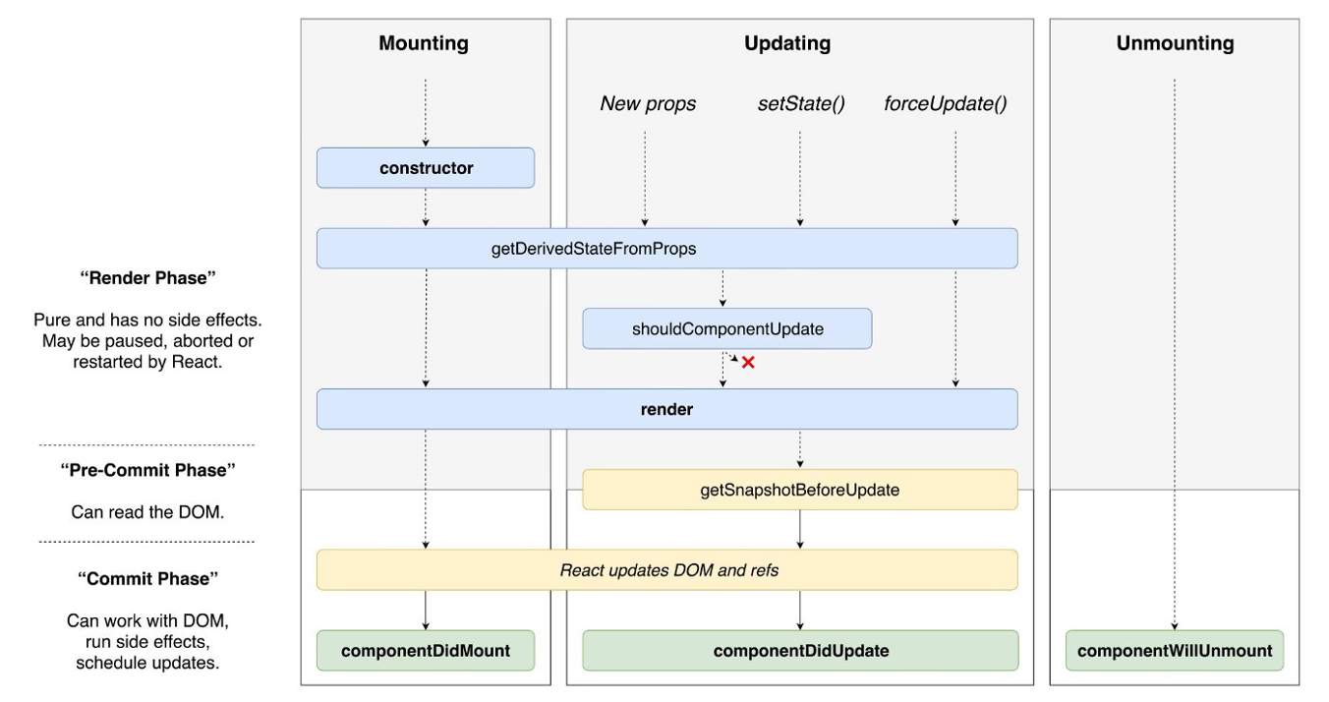
State and Lifecycle
Image Source: https://miro.medium.com/max/1400/0*2Y__6_3e2eiN8h6A

Slide 35
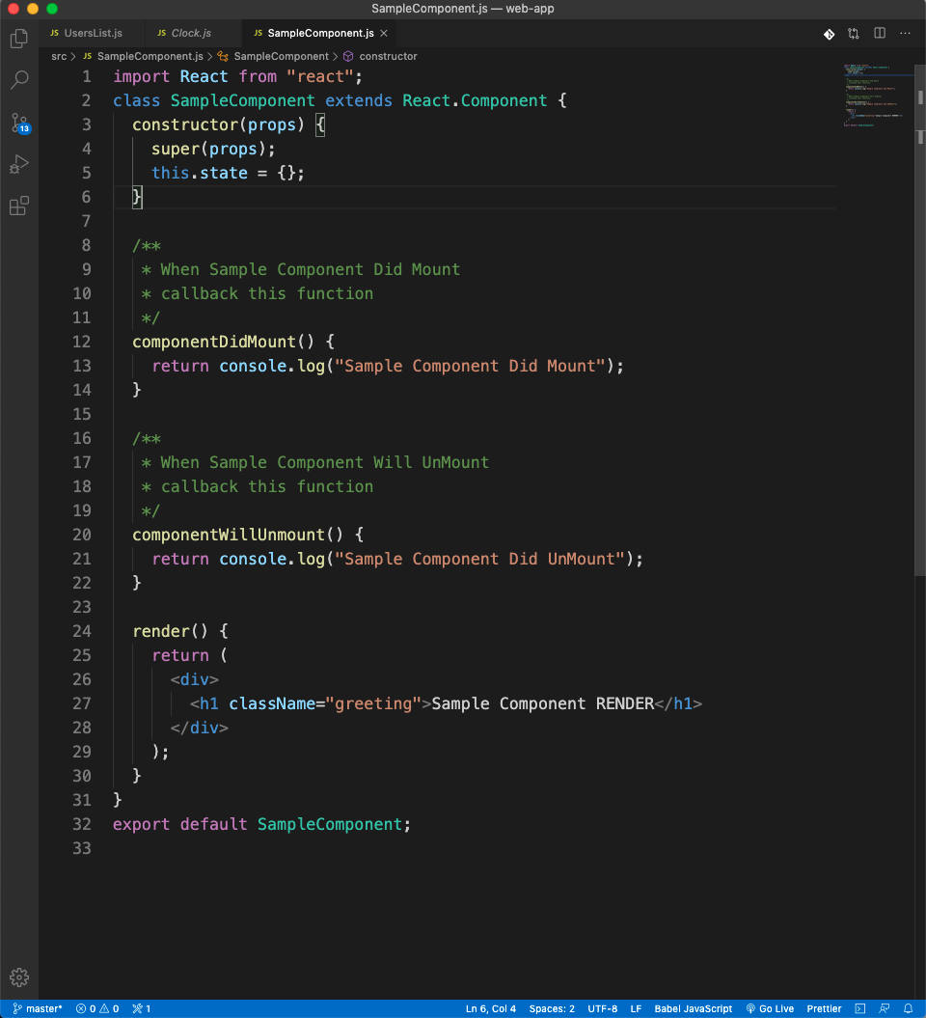
State and Lifecycle
Mounting: Component is rendered to the DOM for the first time
Unmounting: When component is removed from DOM

Slide 36
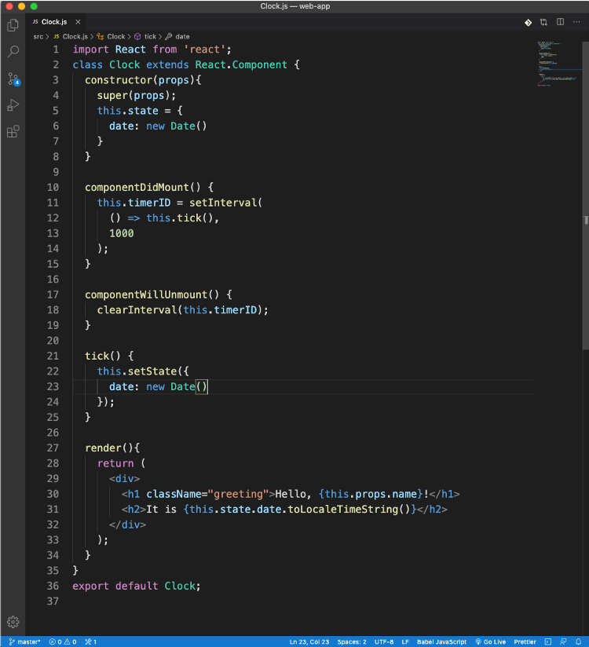
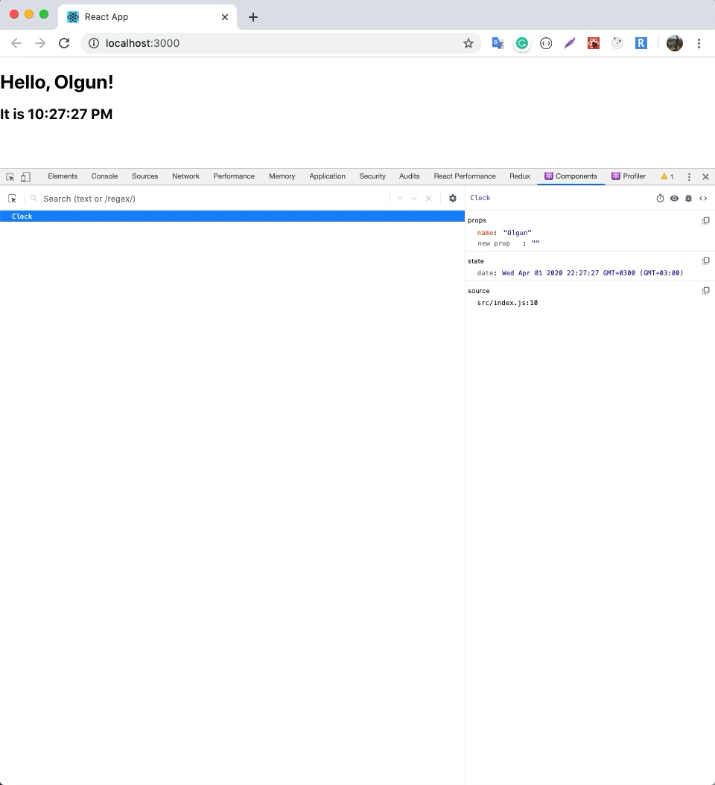
State and Lifecycle

Slide 37
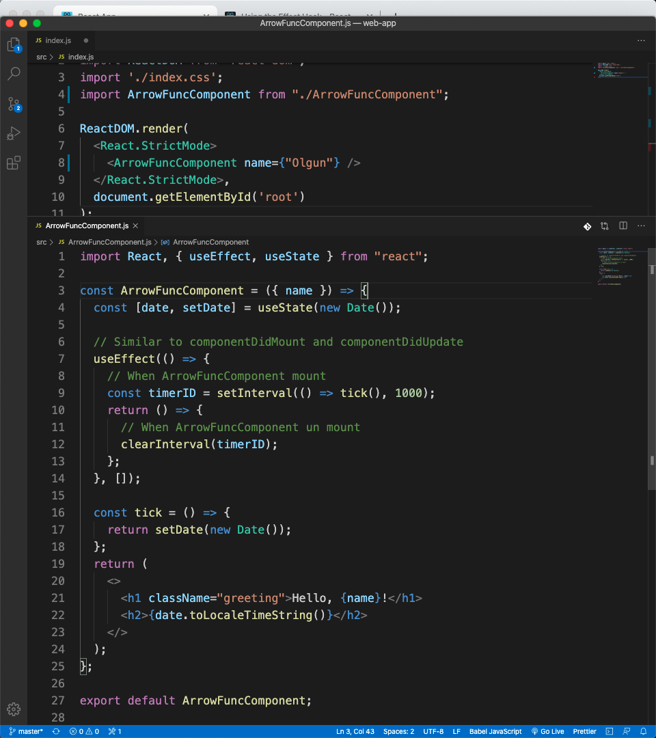
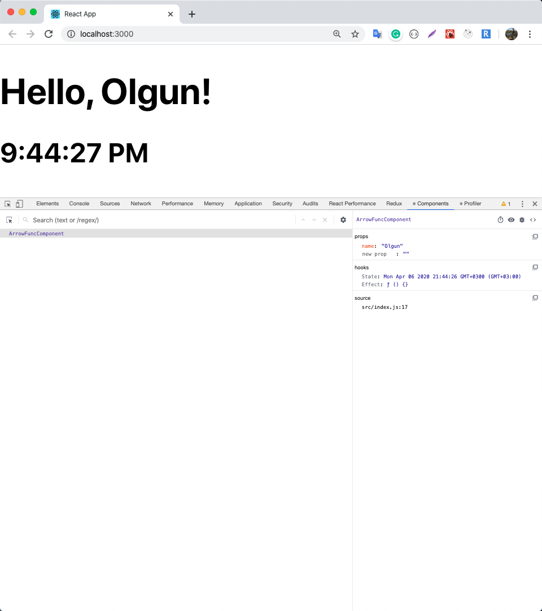
Working With Hook

Slide 38
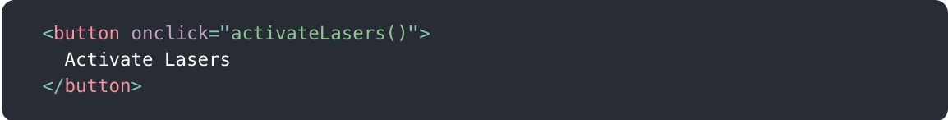
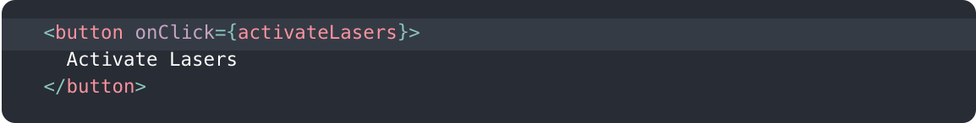
Handling Events
Handling events with React elements is very similar to handling events on DOM elements.
React events are named using camelCase, rather than lowercase.
With JSX you pass a function as the event handler, rather than a string.

Slide 39
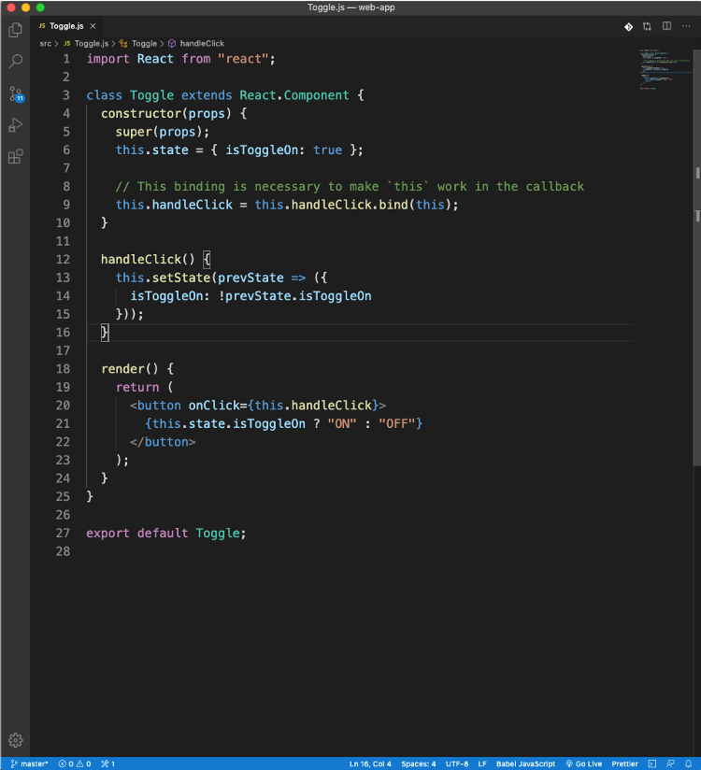
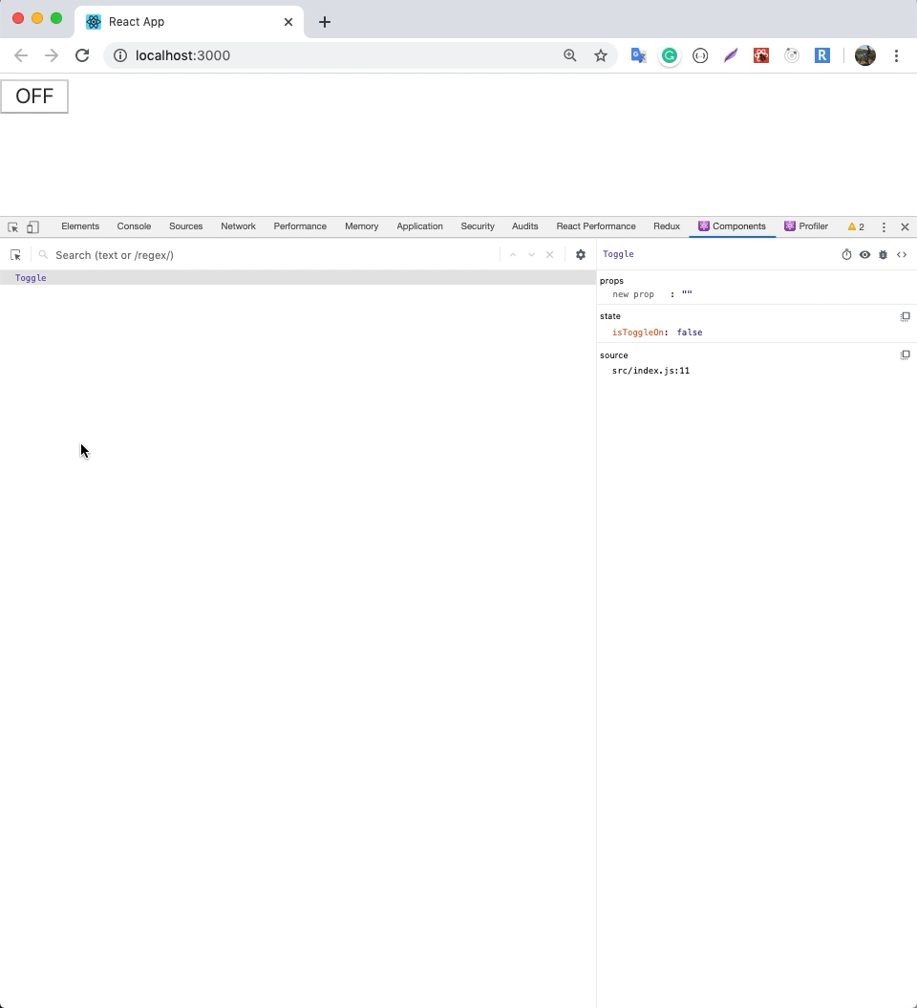
Handling Events

Slide 40
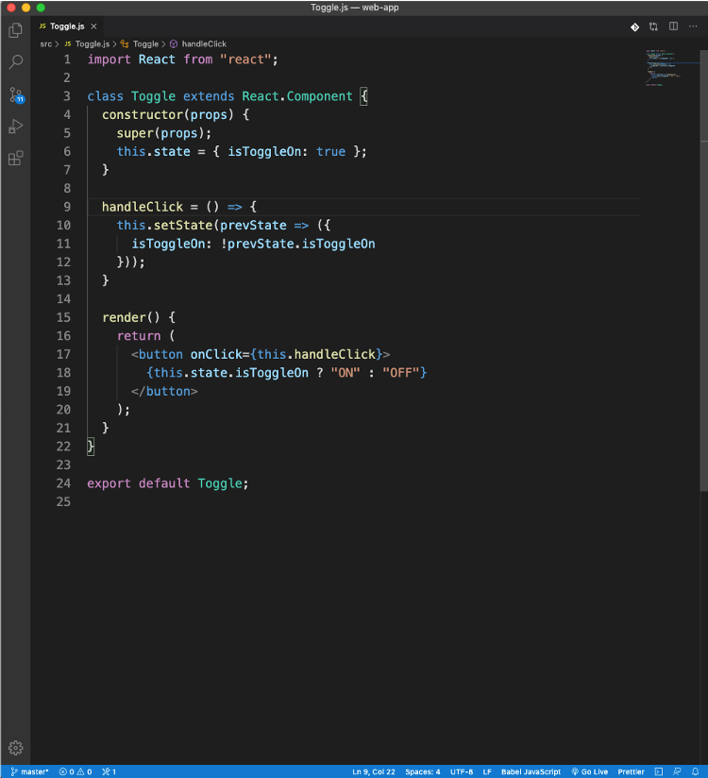
Handling Events

Slide 41
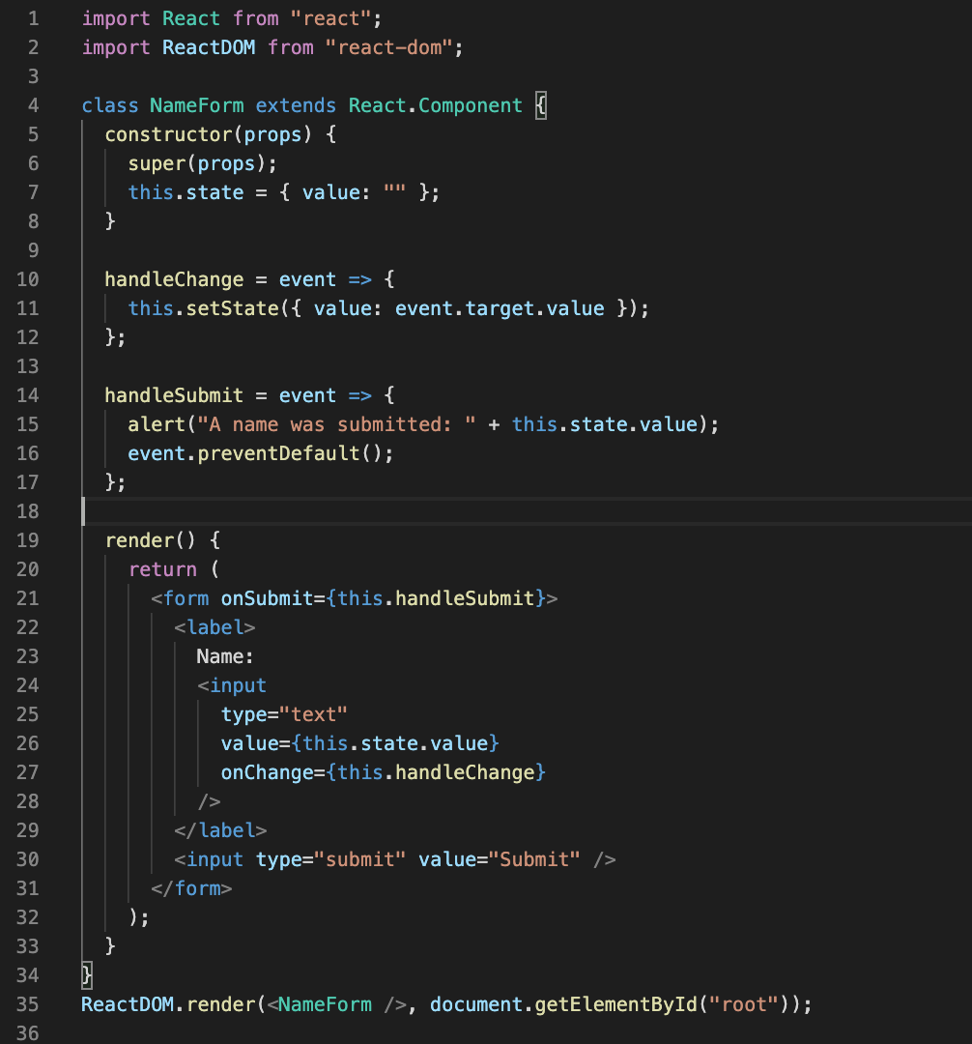
Forms
HTML form elements work a little bit differently from other DOM elements in React, because form elements naturally keep some internal state.

Slide 42
How can I make an AJAX call?
An Ajax call is an asynchronous request initiated by the browser that does not directly result in a page transition.
You can use any AJAX library you like with React
Axios
jQuery AJAX
window.fetch

Slide 43
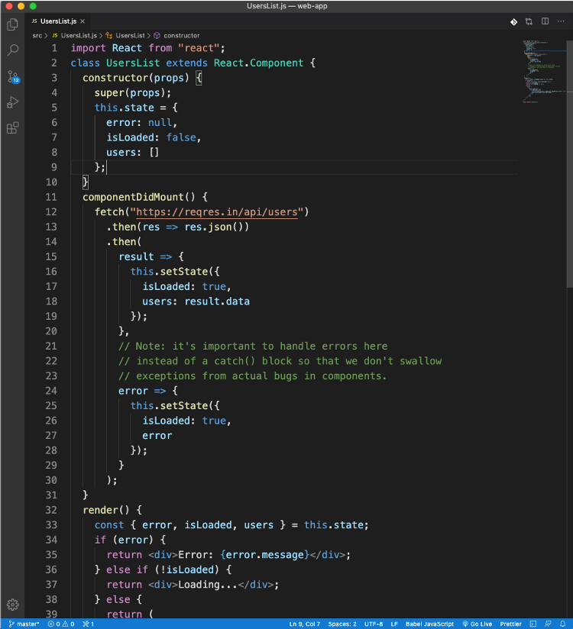
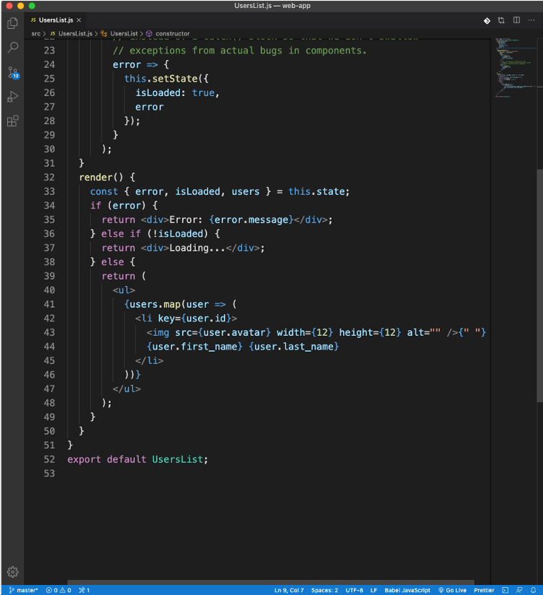
How can I make an AJAX call?

Slide 44
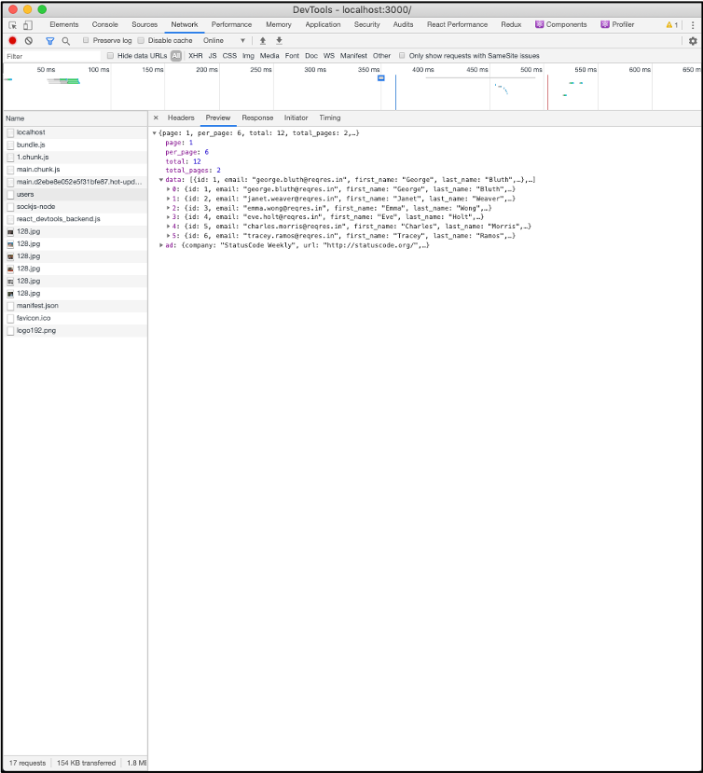
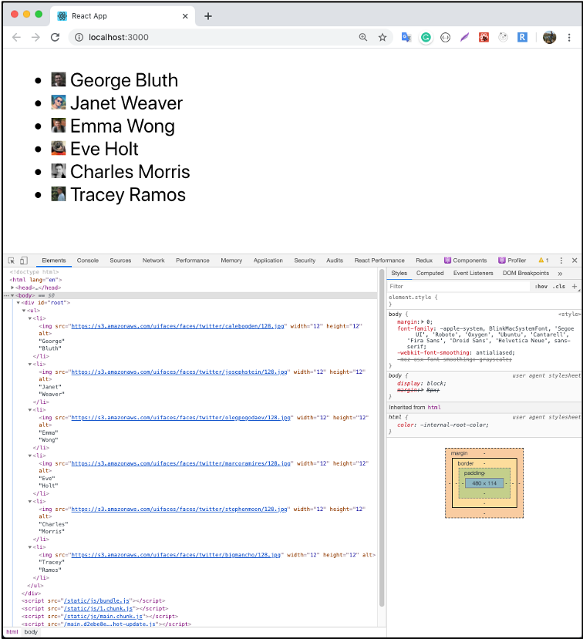
How can I make an AJAX call?

Slide 45
Populer Libraries and Tools
REACT-ROUTER-DOM
REDUX
REDUX-DEVTOOL
REACT DEVELOPER TOOLS

Slide 46
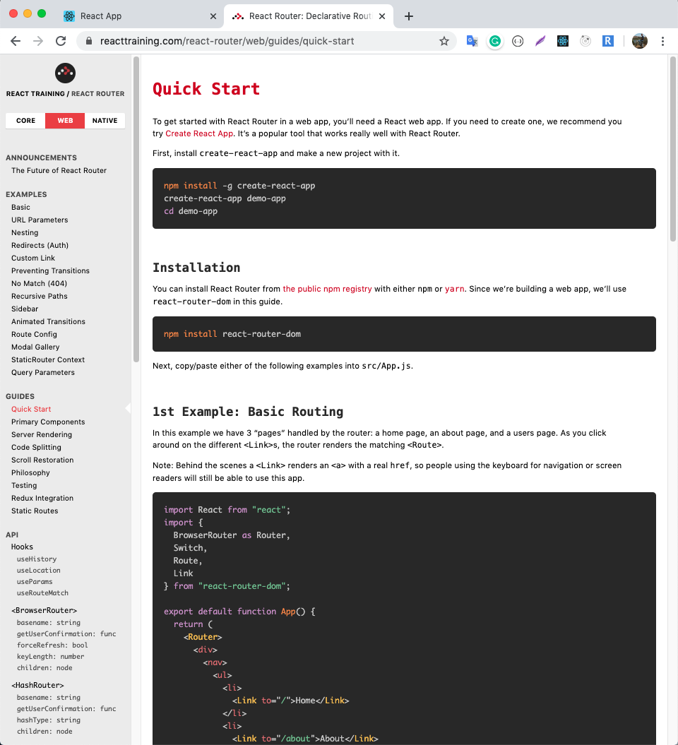
REACT-ROUTER-DOM
https://reacttraining.com/react-router/web/guides/quick-start
React Router is a library that provides navigation between the components in your application.
React Router works wherever React is rendering
`npm install react-router-dom`

Slide 47
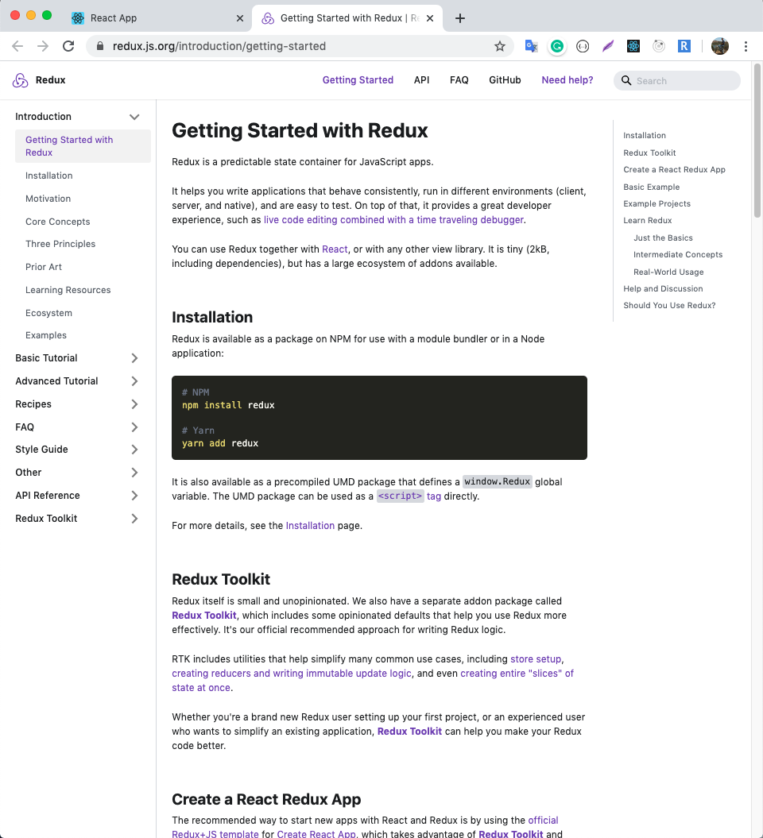
REDUX
https://redux.js.org/introduction/getting-started
Redux is an open-source JavaScript library for managing application state.
It helps you write applications that behave consistently, run in different environments and are easy to test.
` npm install redux `

Slide 48

Redux Lifecycle
Image Source: https://bit.ly/2xGdRGp

Slide 49

REDUX-DEVTOOL
http://extension.remotedev.io/
Redux DevTools for debugging application's state changes.
Added as an attachment to popular browsers such as Chrome Firefox

Slide 50

REACT DEVELOPER TOOLS
React Developer Tools is a Chrome DevTools extension for the open-source React JavaScript library.
It allows you to inspect the React component hierarchies in the Chrome Developer Tools.

Slide 51

Material UI
https://material-ui.com/
Material-UI is an open-source project that features React components that implement Google’s Material Design.
A popular React UI framework

Slide 52
Installation Material UI on Your React APP
Install Material-UI's source files via npm
` npm install @material-ui/core `

Slide 53

Material UI Usage

Slide 54

Socket.io
https://socket.io/
Socket.IO is a JavaScript library for realtime web applications.
It enables realtime, bi-directional communication between web clients and servers.
It has two parts: a client-side library that runs in the browser, and a server-side library for Node.js.

Slide 55


Socket.io

Slide 56

Build
All you must do is to run the build script.
`npm run build`

Slide 57
Tutorials
https://developer.mozilla.org/en-US/docs/Web/JavaScript/A_re-introduction_to_JavaScript
https://docs.npmjs.com/creating-a-package-json-file
http://es6-features.org
https://docs.npmjs.com/files/package.json
https://reactjs.org/docs/dom-elements.html#style
https://havelsan.udemy.com/organization/search/?src=ukw&q=react

Slide 58
References
What is the difference between JavaScript and ECMAScript?
https://en.wikipedia.org/wiki/List_of_ECMAScript_engines
https://reactjs.org/
https://socket.io/

Slide 59
Thanks for listening…

